Slide 1
Homework Assignment 4
Digital Image Processing
Fall 2023
Deadline: 09:00 AM, Monday, 11/20/2023

Slide 2
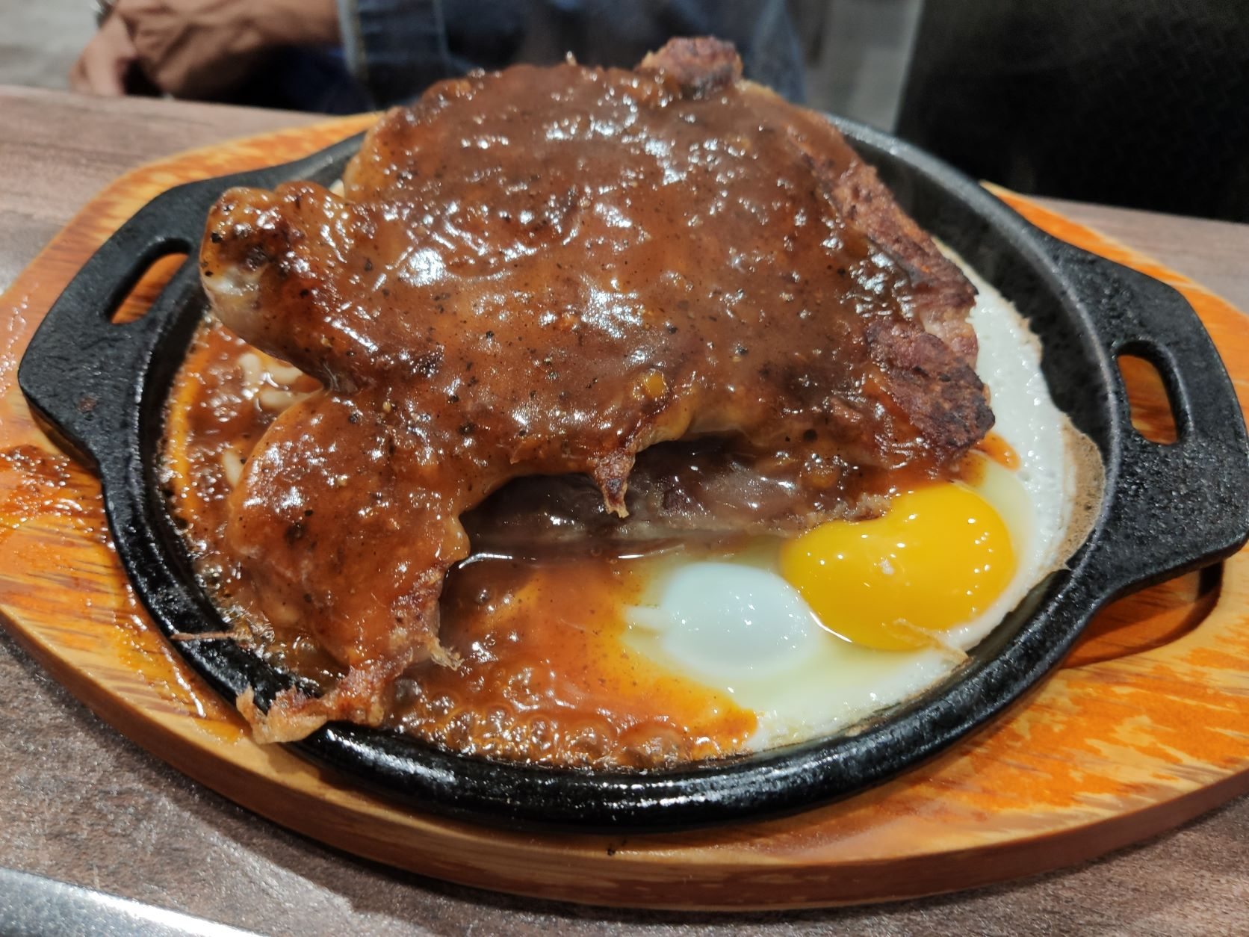
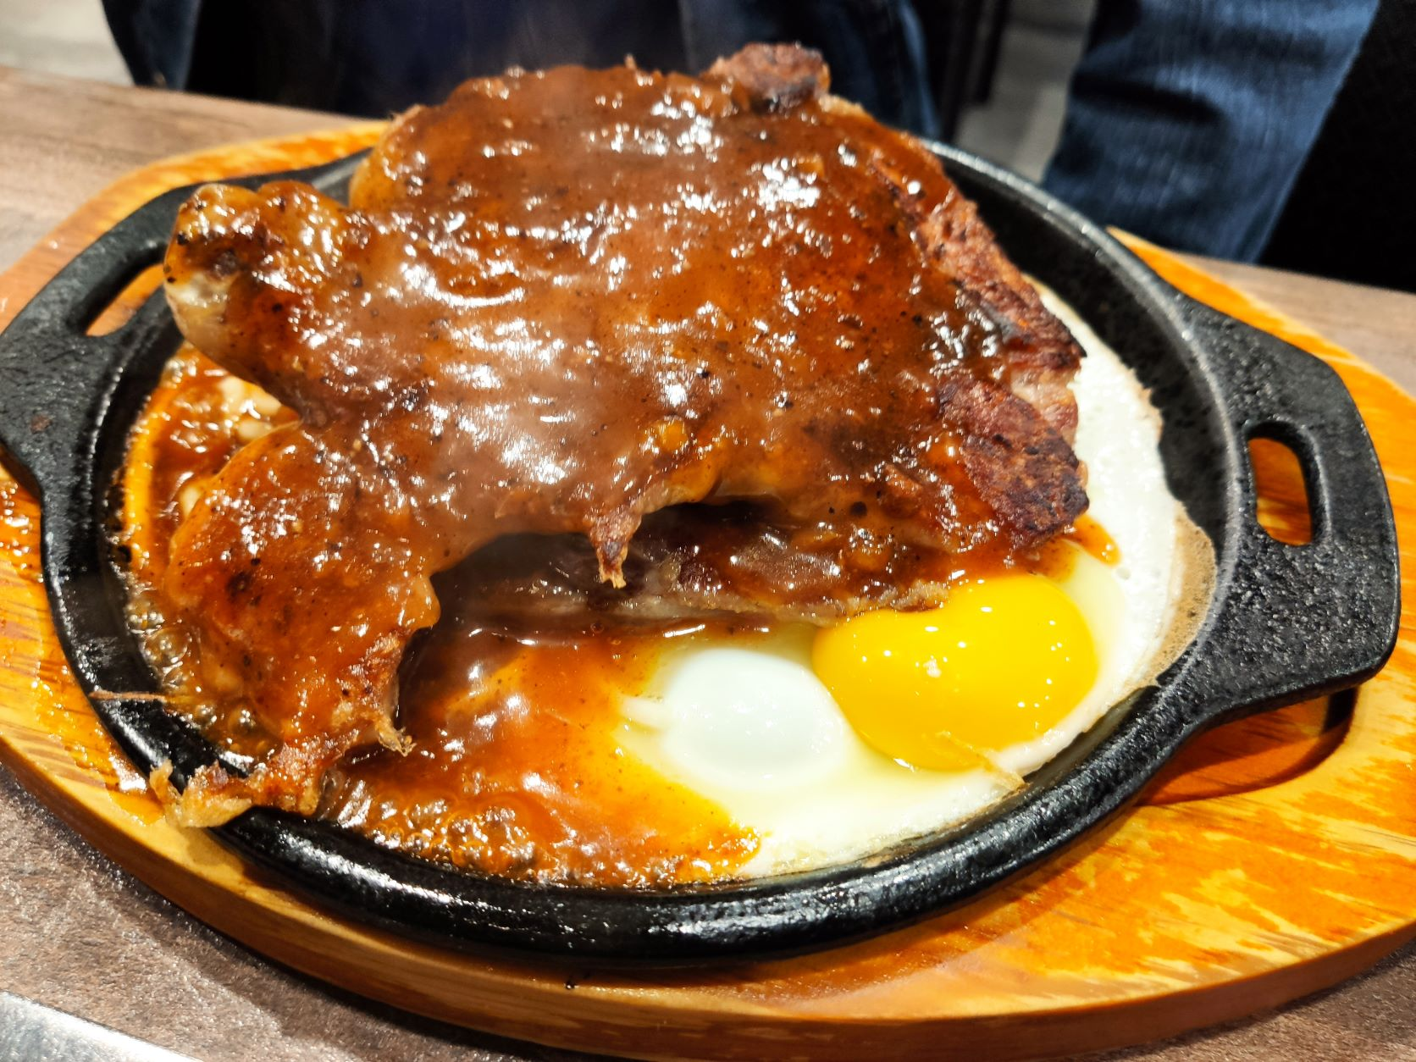
Problem 1 (50%)
Refer to the two images of a steak dinner plate below. The left one of is the original photo, and the right one is an enhanced photo. It is commonly agreed that the enhanced photo looks much better. In this homework, you are asked to start with the techniques described in Section 6.5 Color Transformations, either one single method or several methods in combination, to enhance the image “steak.jpg.” You are encouraged to create your own technique. Creative ideas will receive bonus points.

Slide 3
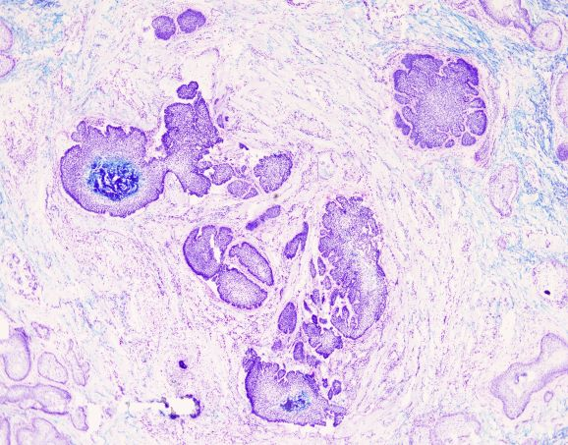
Problem 2 (50%)
Color is a useful piece of information for image segmentation. In this homework, you are asked to apply techniques such as those described in Section 6.7 Using Color in Image Segmentation to segment the basal cell carcinomas (the purple areas) from a skin tissue image. You are encouraged to create your own techniques beyond the basic approaches described in the textbook.

Slide 4
Software Package Allowed
Python 3.8+
Standard Python library
Numpy 1.21.1
Opencv-python 4.5.1
Matplotlib 3.6.0

Slide 5
Assignment Requirements
All functions in the Software Package are allowed.
Set your directory structure as follows (otherwise -5 points):
r129XXXXX/
- p1.py
- p2.py
- report.pdf
- images/
- 20-2851.tif, steak.jpg
- Images of program output (Please use concise and clear file names for the images.)

Slide 6
Assignment Submission Requirements
Submit to NTU COOL
Deadline: 09:00 AM, Monday, 11/20/2023
Do NOT copy homework (code, report, results, etc.) from others

Slide 7
Grading Policy
Problem 1 (50%)
40%, based on the quality of the result
10%, based on the result of additional techniques you apply to enhance the image.
Problem 2 (50%)
40%, based on the quality of the result
10%, based on the result of additional techniques you apply to improve the quality of the segmented regions.

